Slide 1
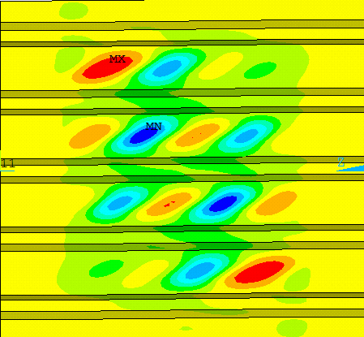
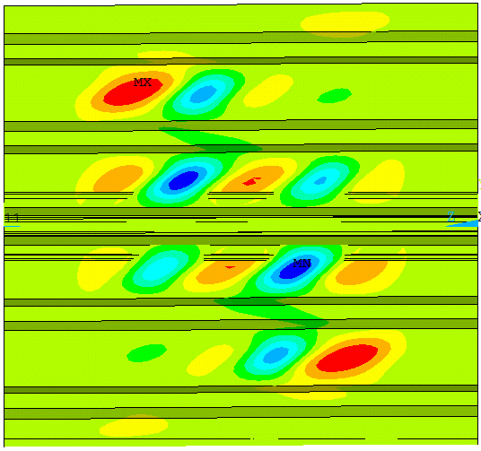
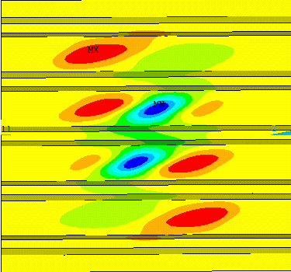
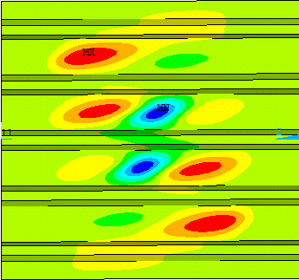
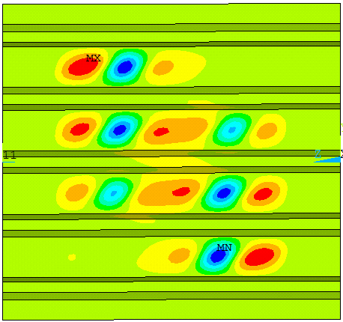
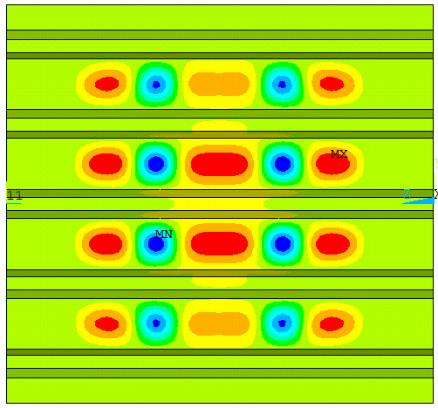
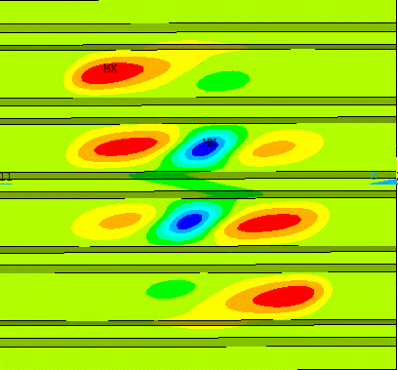
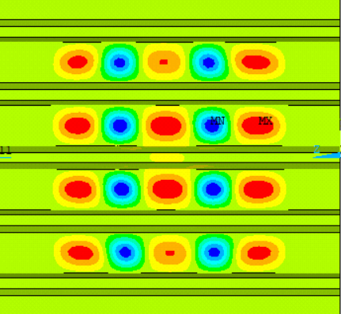
R_{c} = 0
R_{c} = 0.25
R_{c} = 0
R_{c} = 0.25
R_{c} = 0.50
R_{c} = 1
R_{c} = 1
R_{c} = 0.50

Slide 2
R_{c} = 0
R_{c} = 0.25
R_{c} = 0.50
R_{c} = 1

Slide 3
R_{θ} = 0
R_{θ} = 0.25
R_{θ} = 0.50
R_{θ} = 1

Slide 4
